Slide 1
salesinsight tab;eau
File created on: 21-12-2022 12:36:42

Slide 2
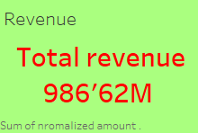

Slide 3
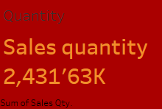

Slide 4
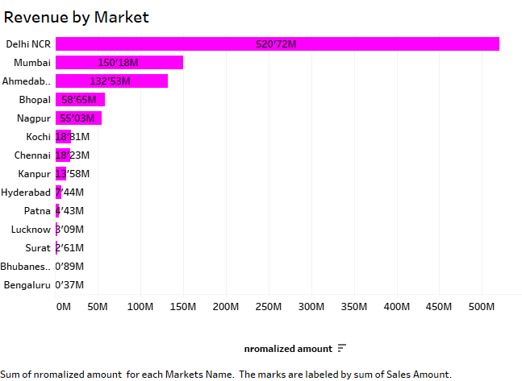

Slide 5


Slide 6


Slide 7
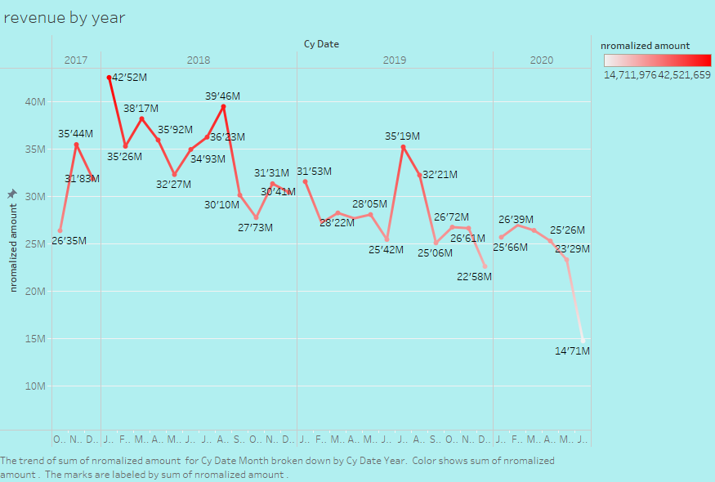

Slide 8
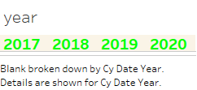

Slide 9


Slide 10
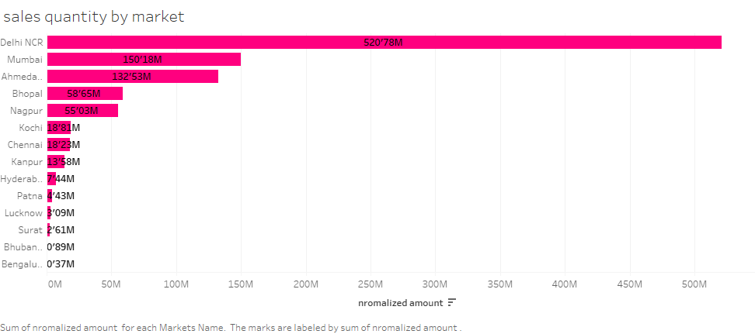

Slide 11
